Slide 1

Team Name : Team Magma
Team Leader Name : Saqib Ahmed K
Problem Statement : Build an AI-powered solution that helps people learn faster, work smarter, or become more productive while building or understanding technology.

Slide 2

Brief about the Idea:
CodeTutor AI is an AI-powered learning assistant designed specially for students, self-taught developers, and early career engineers in India who are learning to code or building tech projects, It acts like a 24/7 personal coding mentor which helping users understand confusing code, debug errors, simplify technical documentation and improve their development window all through a simple chat like interface.
Built on AWS cloud services and powered by generative AI (Amazon Bedrock), CodeTutor doesn’t just give answers it teaches concepts. Whether you’re stuck on a NullPointerException, trying to understand a React hook or overwhelmed by API docs, CodeTutor breaks it down in a clear, beginner-friendly language so you learn faster and build smarter.
It’s not just another code generator, it is a learning accelerator for the next generation of Indian developers.

Slide 3
Your solution should be able to explain the following:
How different is it from any of the other existing ideas?
Most AI coding tools (e.g., GitHub Copilot) generate code but don’t teach understanding.
Along with understanding our code also recommends suitable remembering techniques and list of real-life applications of any given topics.
Search engines and forums require users to phrase perfect queries a major barrier for beginners.
CodeTutor works context-first: paste code → get explanation, paste error → get fix. No prompt engineering needed.
Designed specifically for learners in India, with emphasis on clarity over cleverness, and education over automation.

Slide 4
Your solution should be able to explain the following:
How will it be able to solve the problem?
Accelerates learning: Turns hours of Googling into seconds of guided insight.
Reduces frustration: Instantly decodes cryptic error messages and complex syntax.
Democratizes mentorship: Brings expert-level guidance to students in Tier 2/3 cities with limited access to coaching.
Boosts productivity: Developers stay in flow—no context switching between IDE, browser, and notes.

Slide 5
Your solution should be able to explain the following:
USP of the proposed solution
“From confusion to clarity in one click.” CodeTutor AI is the only tool that combines code explanation, debugging, documentation summarization, and workflow coaching into a single, beginner-optimized experience—built on secure, scalable AWS infrastructure for India’s next million developers.

Slide 6
List of features offered by the solution
Code Explainer : Paste any code snippet → get a line-by-line breakdown in simple English.
Bug Decoder : Paste an error message (with or without code) → get root cause + fix.
Doc Summarizer : Paste technical documentation → get a concise, structured TL;DR.
Workflow Coach : Ask “How do I improve?” → get personalized productivity tips.
Beginner Mode : Simplifies responses for new learners (toggle on/off).
Active Learning Techniques : A combination of understanding, learning and execution.
Future Implementation : Regional language support via Amazon Translate (Hindi, Tamil, Bengali, etc.).

Slide 7
Process flow diagram or Use-case diagram
User Input
Input Analyzer
Detects if Input is Code, Error, Doc or Question
If Code : Step by step explanation
If Error : Diagnosis + Solution
If Doc :
Key points + usage tips
If Question :
Actionable advice
AI Response
Provides an explanation of the concept along with remembering techniques and applications
(User can copy, save, simplify or ask to re-diagnose)

Slide 8
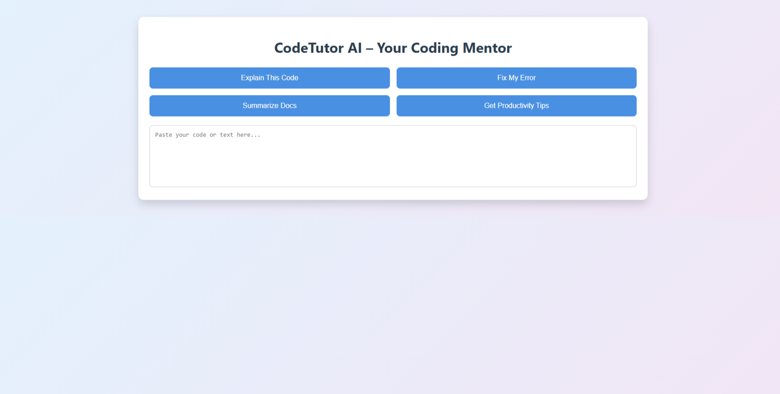
Wireframes/Mock diagrams of the proposed solution

Slide 9
Architecture diagram of the proposed solution:
Frontend :
React Web App hosted on AWS Amplify
Amazon API Gateway
AWS Lambda :
Python processing request
Amazon S3 :
Stores anonymized session logs and cached summaries
Amazon CloudWatch : monitors performance and errors
Amazon Bedrock :
Claude3.5, Sonnet or Llama AI Inference

Slide 10
Technologies to be used in the solution:
Frontend: React.js + CSS
Hosting: AWS Amplify
Backend: AWS Lambda (serverless functions)
AI Engine: Amazon Bedrock (Claude 3.5 or Llama 3)
API Management: Amazon API Gateway
Storage: Amazon S3
Monitoring: Amazon CloudWatch
Future Implementation: Amazon Translate for regional language support

Slide 11
Add as per the requirements for the hackathon:
CodeTutor AI directly advances Digital India, Skill India, and Startup India by:
Making high-quality tech education accessible, affordable, and inclusive
Empowering students in non-metro regions to compete globally
Reducing reliance on expensive coaching or urban tech hubs
Building a self-reliant developer ecosystem across Bharat

Slide 12


